Slide 1


CSCI316 Group Presentation
Scikit-Learn & Spark MLlib Comparative Analysis
Group 16 Members:
Juwon (8761838)
Marvin (8496390)
Michelle (9089202)
Vanness (8561515)
Notes:
1

Slide 2
Project & Dataset Overview
Objective
Dataset
Name: UNSW_NB15
Size: 45 features/ 257,673 rows
Data Loaded and Split:
Train: (180,371, 42) - 70%
Val: (38,651, 42)- 15%
Test: (38,651, 42) - 15%
Class Distribution: Normal: 36.09%, Attack: 63.91%
Compare ML pipelines built with Scikit-Learn and Spark MLlib on the same dataset.
Task Delegation
Goal
EDA, preprocessing, feature engineering - Juwon
Logistic Regression - Marvin
SVM - Vanness
Random Forest - Michelle
Identify the best-performing model for each framework and compare overall results.
Compare Scikit-Learn and Spark MLlib overall.
Notes:
2

Slide 3
Attack and Attributes
DoS / DDoS
Port Scan / Reconnaissance
ct_dst_sport_ltm
ct_src_dport_ltm
ct_state_ttl
sttl / dttl
rate
ct_srv_dst
ct_dst_ltm
spkts / dpkts
....
....
Exploits
Brute Force
dload / sload
dbytes / sbytes
response_body_len
trans_depth
ct_ftp_cmd
is_ftp_login
ct_src_ltm
sinpkt / dinpkt
....
....
Notes:
2

Slide 4
Major columns explained
rate
High packet or session rate per second indicates traffic flooding or abnormal burst behavior.
sbytes / dbytes
Abnormal imbalance or extreme values in source–destination byte volume indicate payload-based attacks or failed probing.
sttl / dttl
Unusual or inconsistent TTL values suggest spoofed traffic or scanning from abnormal network paths.
spkts / dpkts
Extremely high or highly asymmetric packet counts indicate one-way flooding or volumetric DoS attacks.
Notes:
2

Slide 5
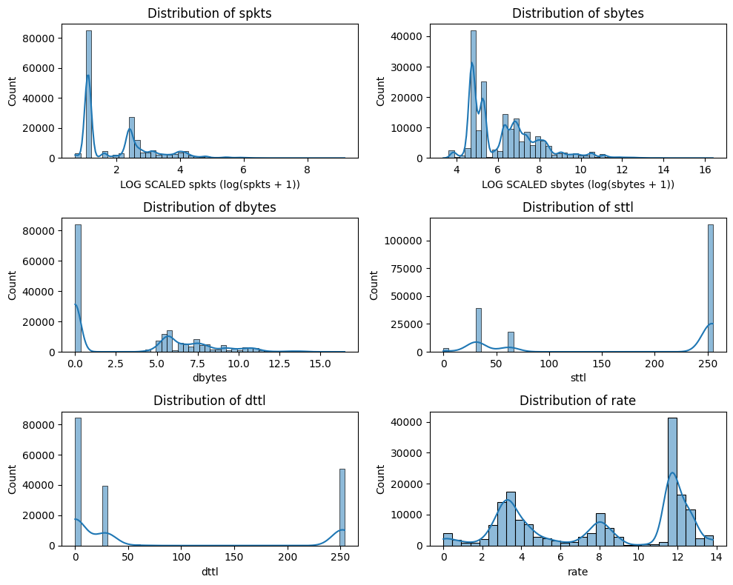
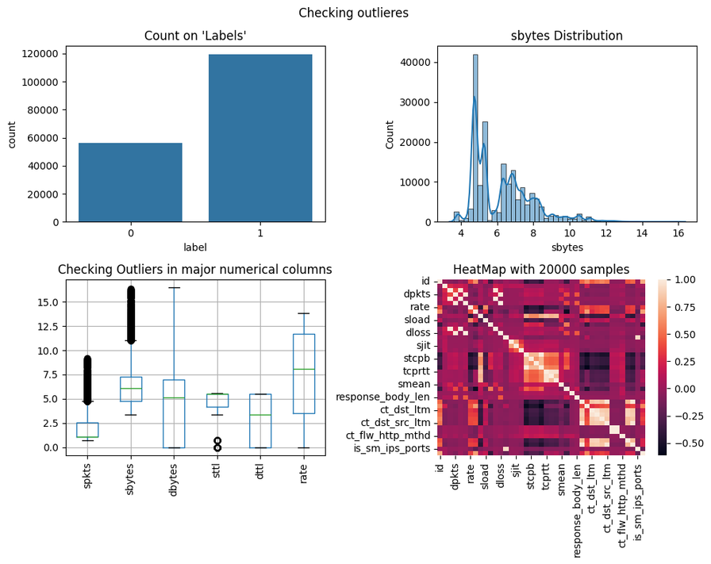
Exploratory Data Analysis
Distribution Analysis
Outlier Visualization
Notes:
3

Slide 6
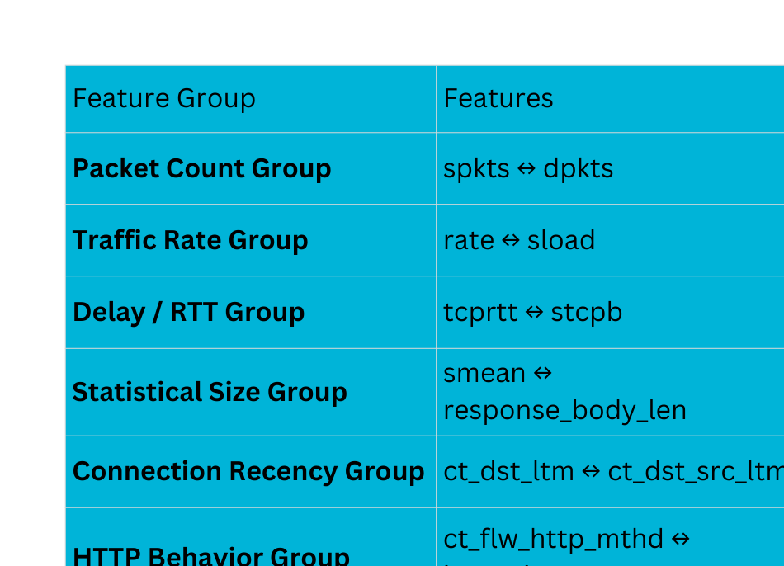
Exploratory Data Analysis
Correlated features
Notes:
3

Slide 7
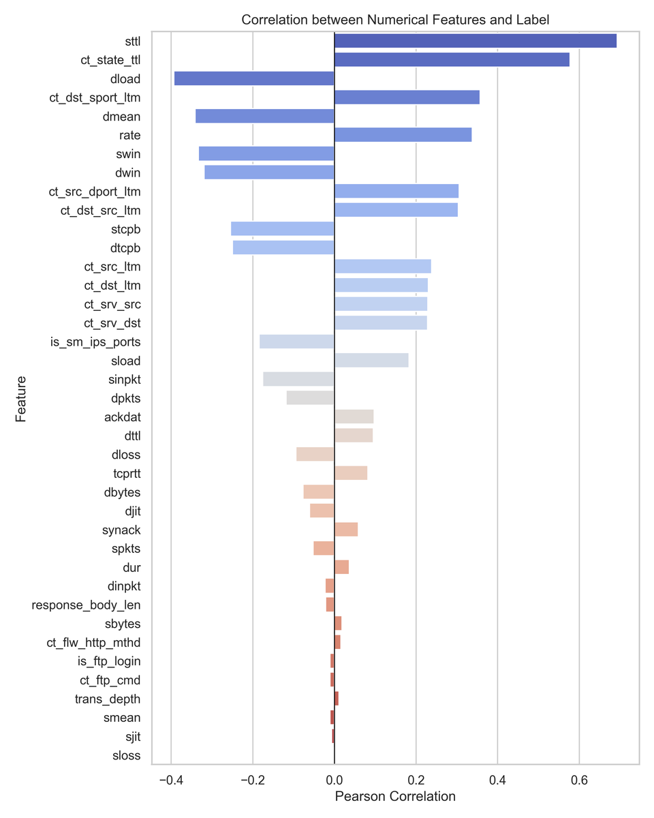
Exploratory Data Analysis
Correlation Graph
Notes:
3

Slide 8
Data Preprocessing
01
02
03
04
05
Data Loading
Feature Engr.
Encoding
Scaling
Train/Test Split
Load Data from the source files
Add new features (pkt_ratio, ttl_gap),
Exclude unnecessary columns
Encode categorical features (OHE / label encoding).
Standardize numerical features
(StandardScaler)
Split data ensuring stratification by target class.
All model Encoding may differ based on the model
Train/Test/Val each split 70/15/15
same column drop
add same feature (2 features)
Notes:
4

Slide 9
Data Preprocessing
Used Different Encoding based on the model
LR/SVM
Cat: OneHotEncoding
Num: StandardScaler
Random Forest
Cat: LabelEncoding (Due to training time)
Num: StandardScaler
EDA/Visualization Testing with Label Encoding
Notes:
4

Slide 10
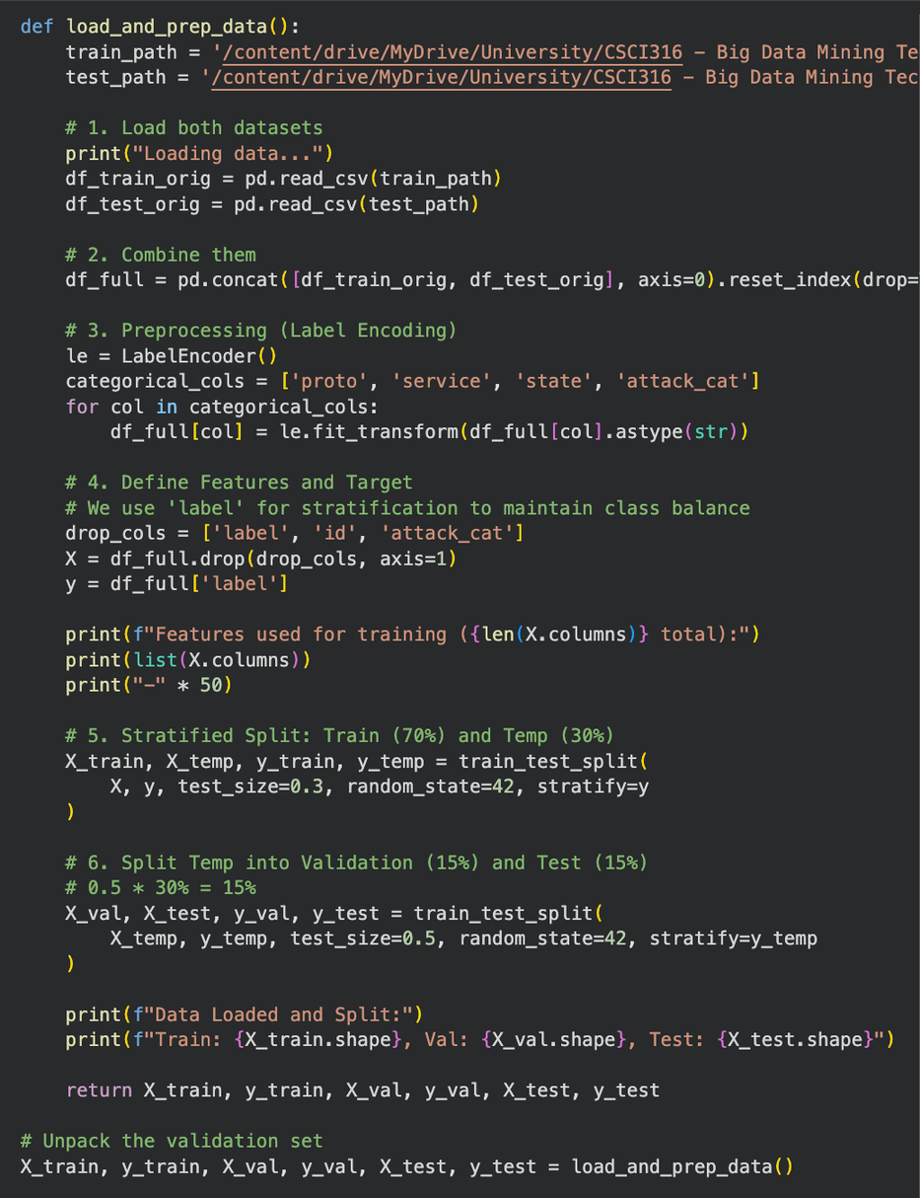
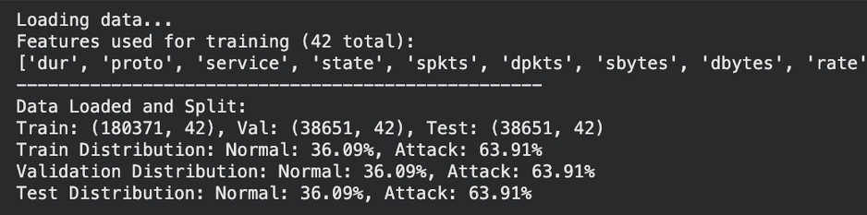
Data Preprocessing
Load Data (load_and_prep_data)
Function
Load Data
Drop ‘id’, ‘attack_cat’, ‘label’
Split into Train/Val/Test (Stratified split)
Output
Notes:
6

Slide 11
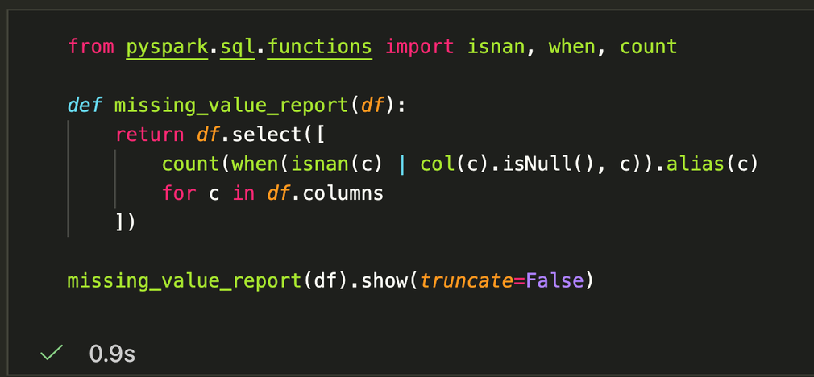
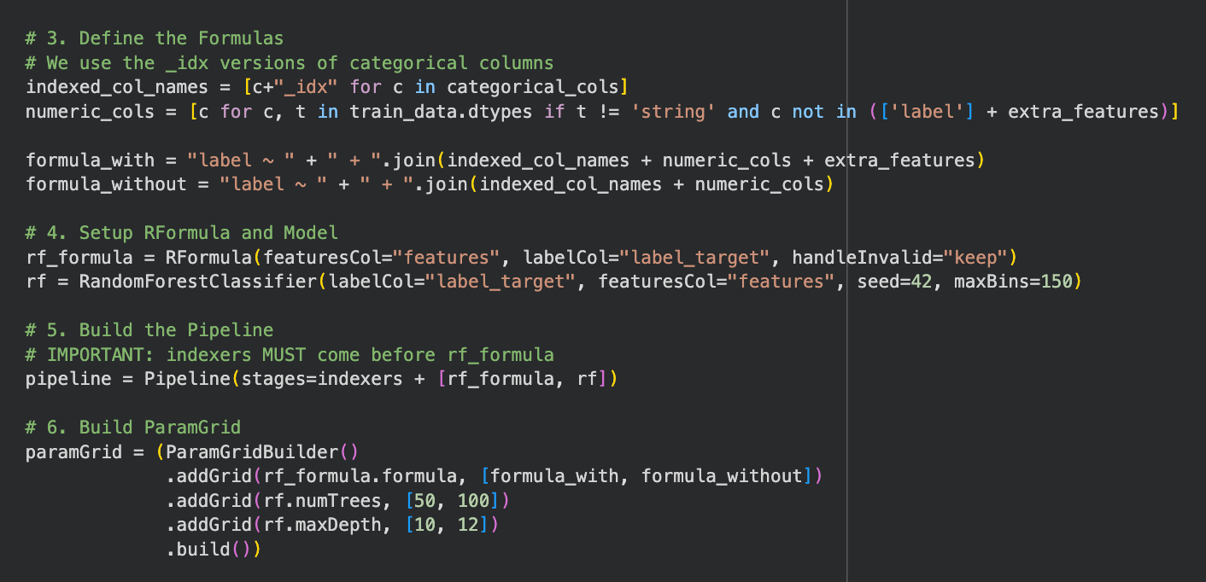
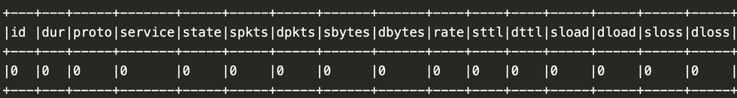
Data Preprocessing (in pySpark)
Report missing value
Generate R Formula and pySpark feature column (in train_spark_rf())
report(no null values in every column)
Notes:
6

Slide 12
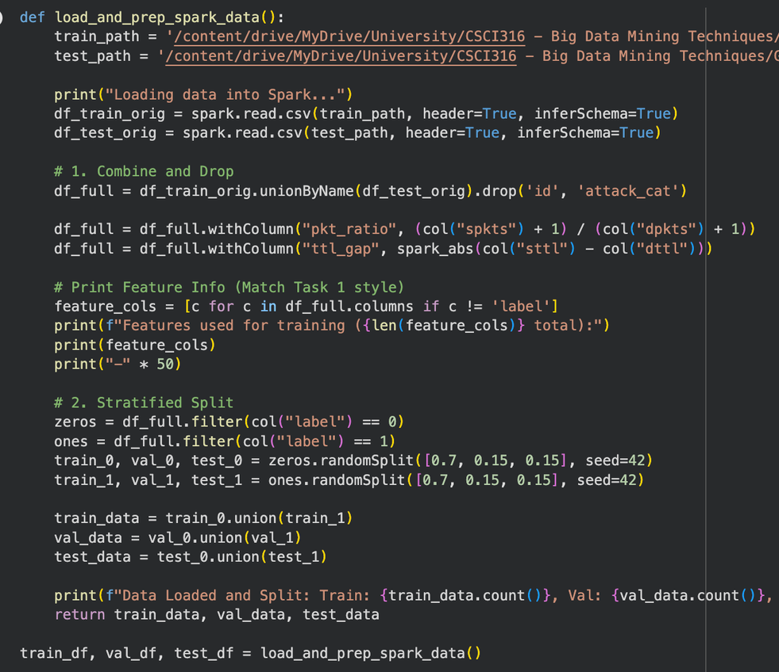
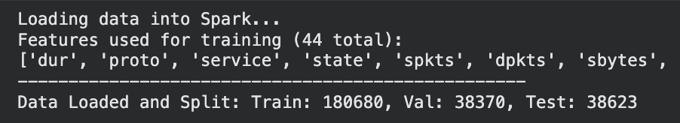
Data Preprocessing (in pySpark)
Load Data (load_and_prep_spark_data)
Function
Load Data
Drop ‘id’, ‘attack_cat’ (label included due to pySpark issue)
Add new columns (pkt_ratio, ttl_gap)
Split into Train/Val/Test (Stratified split)
Output
Notes:
6

Slide 13
Feature Engineering
New added features
pkt_ratio
Detect packet traffic imbalances
pkt_ratio = (spkts + 1) / (dpkts+ 1)
ttl_gap
Detect packet ttl symmetricity or chance of packet spoofing
ttl_gap = abs(sttl - dttl)
Notes:
6

Slide 14

Model Selection
Logistic Regression
Support Vector Machine
Random Forest
Marvin
Vanness
Michelle
▸ Benchmark baseline
▸ Maximized margin
▸ Stable ensemble
▸ Highly interpretable
▸ High dimensionality
▸ Non-linear patterns
▸ Real-time speed
▸ Noise resistant
▸ Outlier robust
▸ Probabilistic output
▸ Binary specialist
▸ Feature importance
Notes:
7

Slide 15





Task 1: Scikit-Learn
Exploratory Data Analysis (EDA)
Analyzed class balance and feature distributions using histograms and heatmaps to detect skewness and correlations.
Data Preprocessing
Merged datasets, dropped columns (id, attack_cat, label), and applied label encoding / one hot encoding & scaling
Feature Engineering
Implemented a custom CustomFeatureTransformer to engineer pkt_ratio and ttl_gap for capturing traffic anomalies.
Hyperparameter Tuning
Optimized model parameters using GridSearchCV with 3-Fold Cross-Validation to maximize F1-Score.
Model Evaluation
Assessed the best model on the Test Set using Weighted F1-Score, Precision, Recall and Confusion Matrix.
Notes:
5

Slide 16
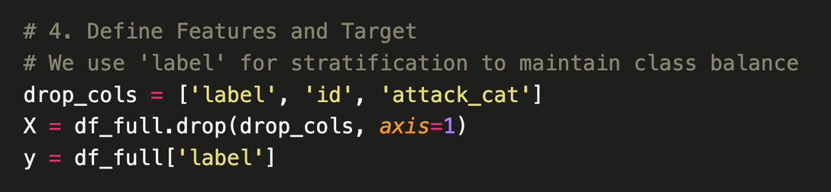
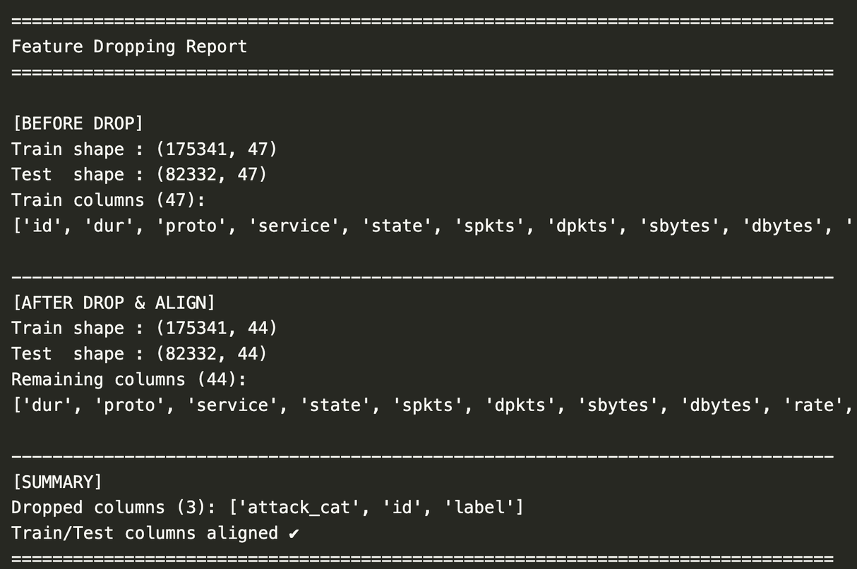
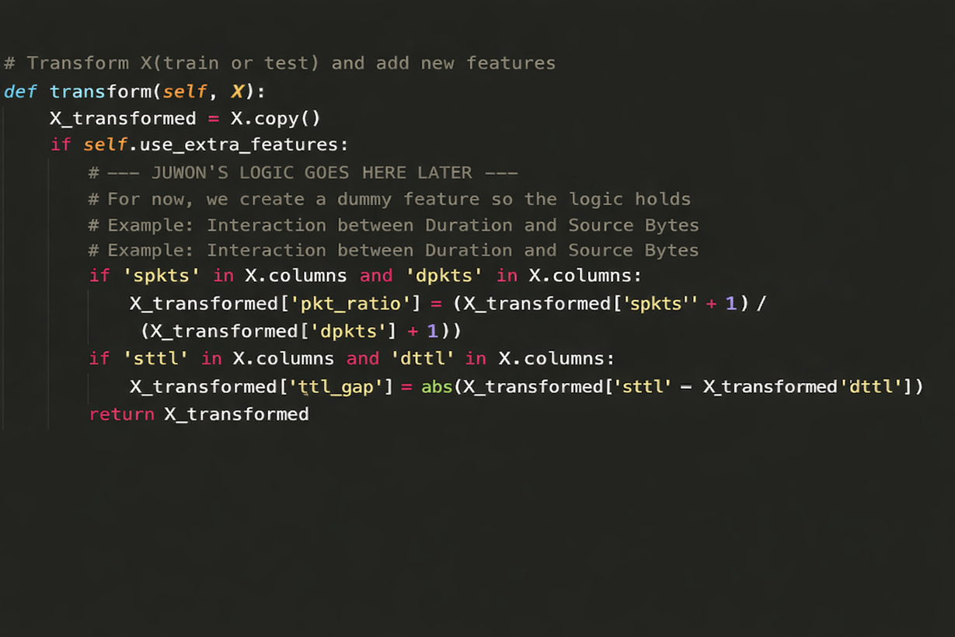
Task 1 · CustomFeatureTransformer
Custom Transformer Class
transform(): adding new features to dataset (pkt_ratio, ttl_gap)
Notes:
6

Slide 17

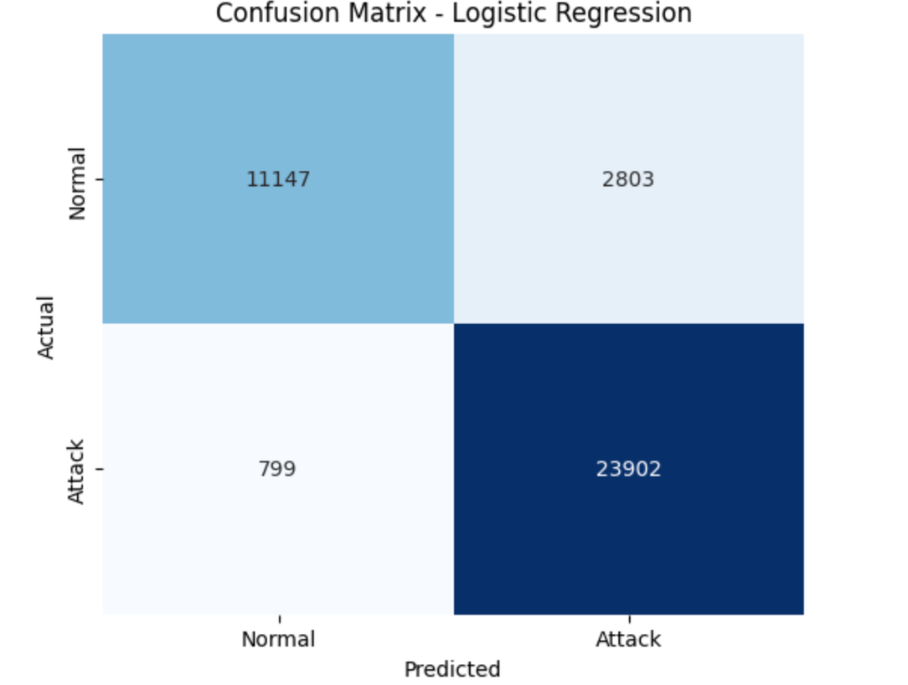
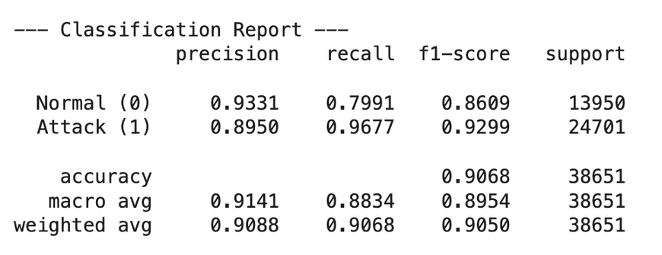
Task 1 · Logistic Regression
Best Parameters:
'custom_transformer__use_extra_features': True,
'lr__C': 10
Validation F1-Score: 0.9287
Notes:
7

Slide 18
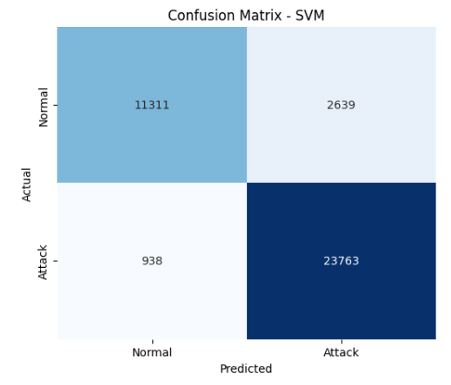
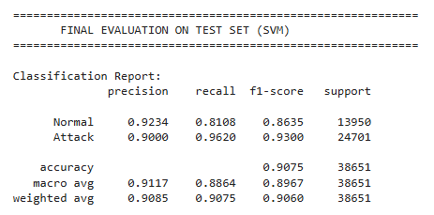
Task 1 · Support Vector Machine
Best Parameters: 'custom_transformer__use_extra_features': True, 'svm__estimator__C': 1
Validation F1-Score: 0.9286
Notes:
7

Slide 19
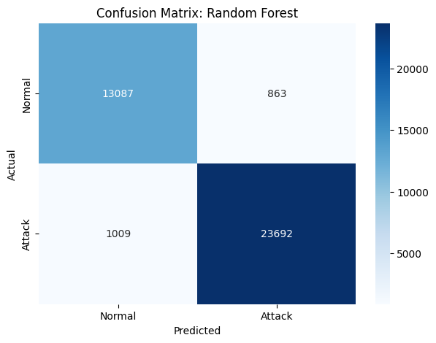
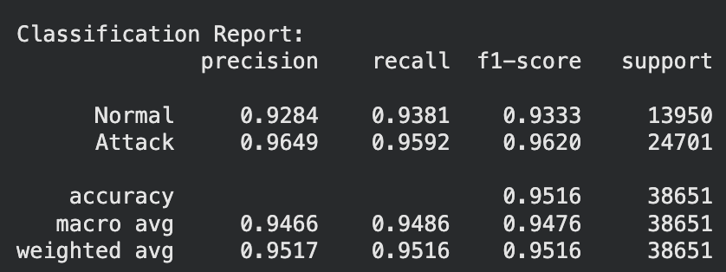
Task 1 · Random Forest
Best Parameters:
'custom_transformer__use_extra_features': True,
'rf__criterion': 'entropy',
'rf__max_depth': None,
'rf__n_estimators': 100
Validation F1-Score: 0.9620
Notes:
7

Slide 20
Task 1 · Model Comparison
Side-by-side results across all three Scikit-Learn models
Metric | Logistic Regression | SVM | ★ Random Forest
Training Time | 237.62 seconds | 2410.77 seconds | 1060.57 seconds
F1 Score | 0.9050 | 0.9060 | 0.9516
Precision | 0.9088 | 0.9085 | 0.9517
Recall | 0.9068 | 0.9075 | 0.9516
★ Best model: Random Forest
Notes:
8

Slide 21
Task 2: Spark MLlib
Exploratory Data Analysis (EDA)
Analyzed class balance and feature distributions using histograms and heatmaps to detect skewness and correlations.
Data Preprocessing
Merged datasets, dropped columns (id, attack_cat), and applied category encoding & scaling using RFormula.
Feature Engineering
Engineered pkt_ratio and ttl_gap using Spark DataFrame operations (withColumn) and RFormula.
Hyperparameter Tuning
Optimized model parameters using Spark’s CrossValidator and ParamGridBuilder
Model Evaluation
Assessed the best model on the Test Set using Weighted F1-Score, Precision, Recall and Confusion Matrix.
Notes:
5

Slide 22

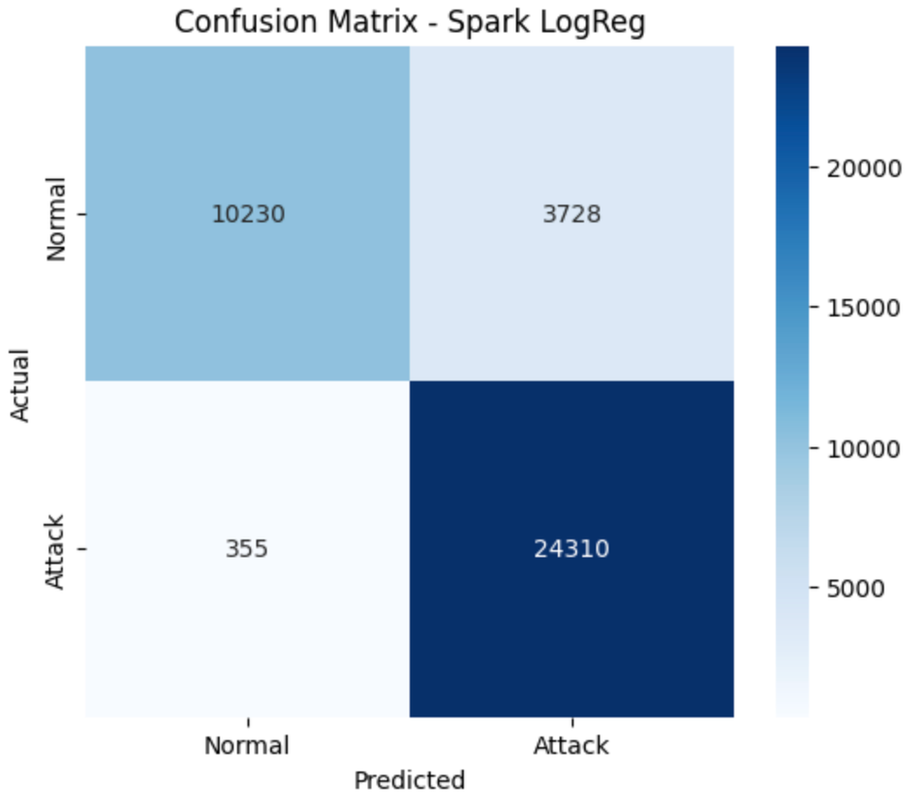
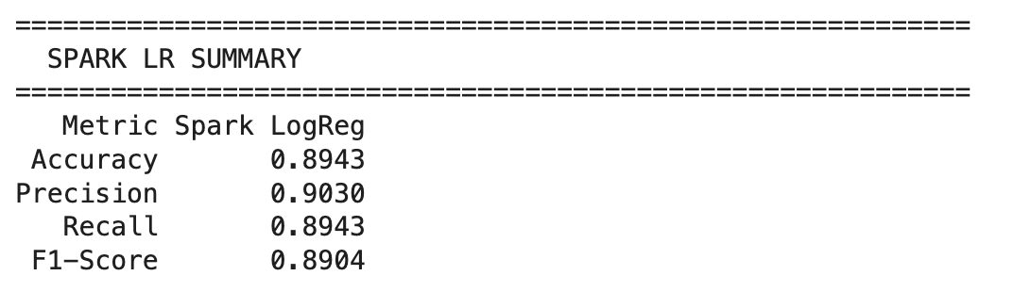
Task 2 · Logistic Regression
Best Parameters:
‘ExtraFeature’: True
‘RegParam’: 0.01
‘ElasticNet’: 0.0
Validation F1-Score: 0.8932
Notes:
7

Slide 23
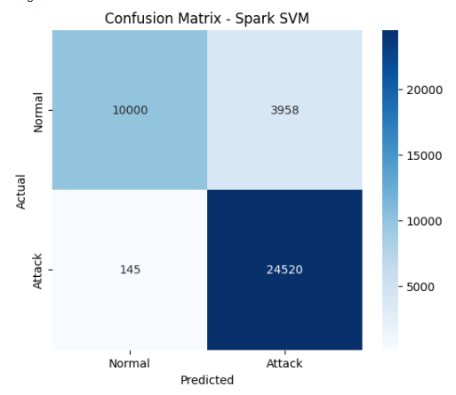
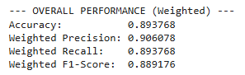
Task 2 · Support Vector Machine
Best Parameters:
‘ExtraFeature’: False,
‘RegParam’: 0.01,
‘Iter’: 100
Validation F1-Score: 0.8904
Notes:
7

Slide 24
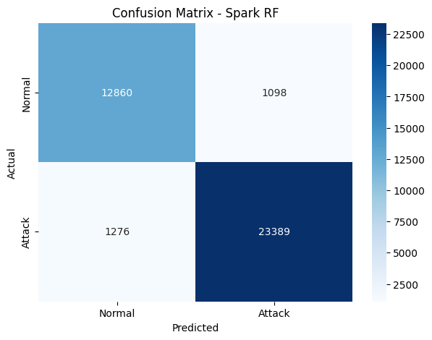
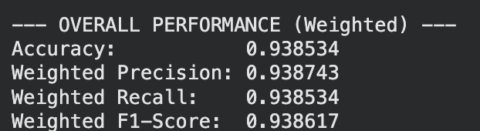
Task 2 · Random Forest
Best Parameters:
'use_extra_features': True,
'numTrees': 100,
'maxDepth': 12
Validation F1-Score: 0.9382
Notes:
7

Slide 25
Task 2 · Model Comparison
Side-by-side results across all three Spark MLlib models
Metric | Logistic Regression | SVM | ★ Random Forest
Training Time | 1057.15 seconds | 1721.19 seconds | 2238.28 seconds
F1 Score | 0.8904 | 0.8891 | 0.9386
Precision | 0.9030 | 0.9060 | 0.9387
Recall | 0.8943 | 0.8937 | 0.9385
★ Best model: Random Forest
Notes:
12

Slide 26

Overall Comparison
Scikit-Learn vs Spark MLlib
Scikit-Learn
Spark MLlib
Best Model: RandomForest
Best Model: RandomForest
F1 Score: 0.9516
F1 Score: 0.9386
Training Time: 1060.57 s
Training Time: 2238.28 s
Average Training Time of 3 Models: 1236.32 seconds
Average Training Time of 3 Models: 1318.26 seconds
Scalability: Limited
Scalability: Distributed
Setup: Lightweight
Setup: Cluster-based
Notes:
13

Slide 27
Thank You
Notes:
1

